Slide 1

Mini Project-I (K24MCA18P)
Odd Semester
Session 2024-25
Resume Builder
Ashutosh Choubey (ashutosh2426mca647)
Anik Arya (anik.2426mca202
Project Supervisor:
Mrs.Divya singhal

Slide 2



Content
Introduction (1 slide)
Literature Review (2 slides)
Objective of the Project (1 slide)
Technology
Hardware Requirements (Development Environment, Server requirement (if required), Client requirement (if required).
Software Requirements (Language and Platforms like Frameworks, VS code, Android Studio and Jupyter notebook etc. )
Modules (2-3 slides)
Workflow (1 slide)
Reports (For Example: Project : Student Monitoring System, so reports like: Student Marks, Subjects, companies visit, and student appears in placement etc.)
References (1 slide)

Slide 3

Introduction
A Resume Builder is a digital tool designed to simplify the process of creating professional resumes. It provides users with an intuitive platform to craft well-structured, visually appealing resumes tailored to their specific career needs. With predefined templates, users can select from various designs, ensuring their resumes stand out while maintaining a polished, professional look.
The tool guides users step-by-step through the resume creation process, prompting them to enter essential details like personal information, education, work experience, skills, and certifications. This ensures that users don't overlook important sections, helping them build comprehensive resumes that highlight their strengths. Customization options allow users to modify layouts, fonts, and sections to align with their individual preferences and the specific job they are applying for.
User-friendly Interface: resumes in real time.
Predefined Templates:
Customizability:
Step-by-Step Guidance:
Download and Export Options:
Cloud Storage:
Integration with Job Portals:.
Key Features:

Slide 4



Literature Review
1. Evolution of Resume Building Tools
Traditional Resume Formats: Early resume builders were largely simple templates that provided static formats for users to input data. Research shows that initial systems were limited to word processors such as Microsoft Word or Google Docs.
Introduction of Online Builders: With the rise of web technologies, online resume builders emerged, allowing users to build resumes more dynamically with drag-and-drop features. Websites like LinkedIn, Resume.com, and Canva offer users ready-to-use templates and professional-looking resumes without requiring design skills. Studies have shown that these tools increase efficiency for job seekers.
ATS( Application Tracking System).
2. AI and Machine Learning in Resume Builders
Keyword Optimization: Many resume builders now include keyword optimization to ensure resumes pass through ATS filters. Research suggests that resumes that include job-specific keywords have a higher chance of being reviewed by hiring managers. ATS typically score resumes based on how well they match job descriptions, and AI systems help enhance this match.
Personalization and Customization: AI-driven resume builders offer personalized suggestions by analyzing the user’s work experience, skills, and education. Research indicates that this feature is highly valued by job seekers, especially for those with less experience or those transitioning between industries.

Slide 5
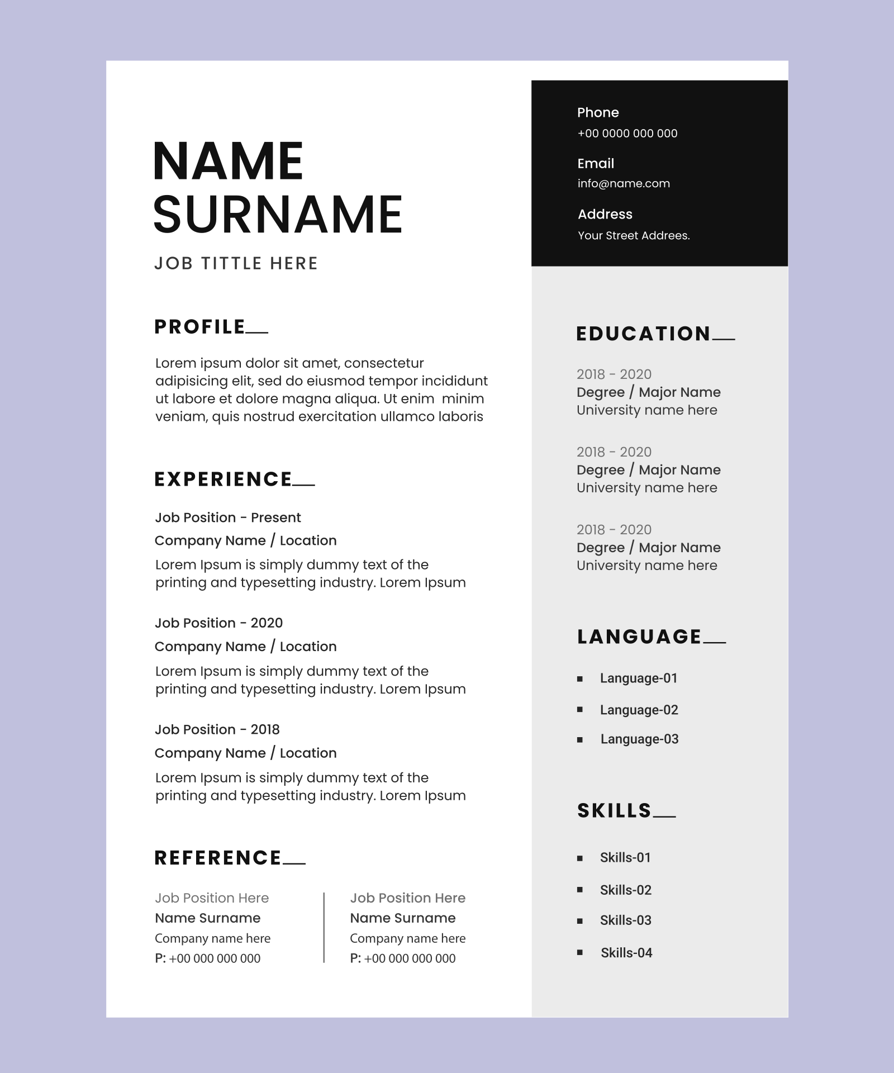
Literature Review
3. Impact of Resume Builders on Job Search Outcomes
Efficiency and Time-Saving: Studies suggest that resume-building tools significantly reduce the time needed to create a professional resume. Automated systems that generate suggestions based on job descriptions can also reduce the time required to tailor resumes to different positions.
Increased Job Placement: Research into the effectiveness of AI-powered resume builders shows that they can enhance the quality of resumes submitted, leading to improved hiring outcomes for users.

Slide 6




Objective of the Project
Streamline the Resume Creation Process
Enhance Resume Quality and Professionalism
Optimize Resumes for Applicant Tracking Systems (ATS)
Customization and Flexibility
Provide AI-Driven Personalization

Slide 7


Technology (Software Requirements)
FRONTEND(USER INTERFACE)
JAVASCRIPT(VANILLA OR FRAMEWORKS)
HTML5
CSS3(TAILWIND OR SCSS)
REACT.JS
DRAG AND DROP LIBRARY
BACKEND
MONGO DB
GITHUB
PUPPETEER
D3 JS
JWT TOKEN
OPEN AI
JEST
VERCEL/NETLIFY

Slide 8

Technology (Hardware Requirements)
Processor (CPU): A multi-core processor (Intel Xeon or AMD EPYC series for servers) is typically sufficient. Even for small websites, at least a dual-core processor is recommended for handling multiple requests simultaneously.
RAM (Memory): A minimum of 2GB to 4GB of RAM is needed for a simple website. However, for websites with dynamic content or moderate traffic, 8GB to 16GB RAM is recommended for better performance.
Storage (HDD/SSD): SSD (Solid State Drive) storage is preferred for its speed and reliability. The required storage depends on the website size (files, databases, etc.), but a minimum of 40GB is recommended for small websites. Larger websites or applications may require more (100GB+), especially if hosting media files.

Slide 9

Modules
User Authentication and Account Management Module
Resume Template Management Module
Resume Template Management Module
PDF/Document Generation Module

Slide 10


Modules (Contd.)
Data Storage and Management Module
User Interface (UI/UX) Module
Payment and Subscription Module
Analytics and Reporting Module
Admin Panel Module
Notification and Email Module

Slide 11



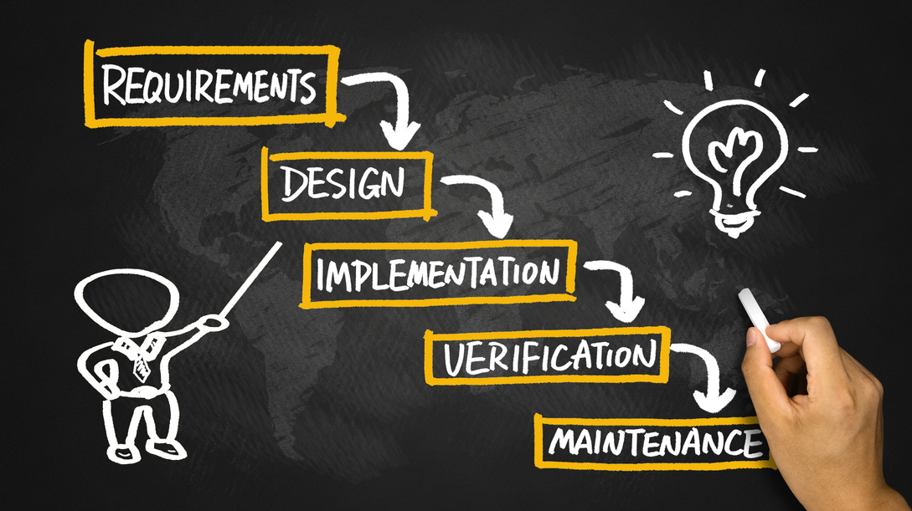
Workflow/Gantt Chart
User Registration/Authentication
User Feedback to improve
our website
Template Selection
Save, Download, or Share
in any format like docs,pdf,jpeg
User Information Input
(Name,Experience,Hobby)
Customization Options
like font picture bullets
rearrange content
Resume Content Optimization
Live Preview

Slide 12

References
w3school.com
canva.com
geeksforgeeks
MDN refrences
Generative AI
Open free sources

Slide 13




